Slide 1
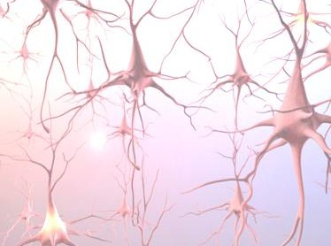



Biological Neuron to Artificial Neural Network
Ref.: Chapter 1: Preliminaries, Deep Learning Fundamentals - A Practical Approach to Understanding Deep Learning
Methods ISBN:978-984-35-0812-6, University Grants Commission (UGC), Bangladesh, 2021
Prof. Dr. Md. Aminul Haque Akhand
Dept. of Computer Science and Engineering (CSE) Khulna University of Engineering & Technology (KUET) www.kuet.ac.bd/cse/akhand

Slide 2
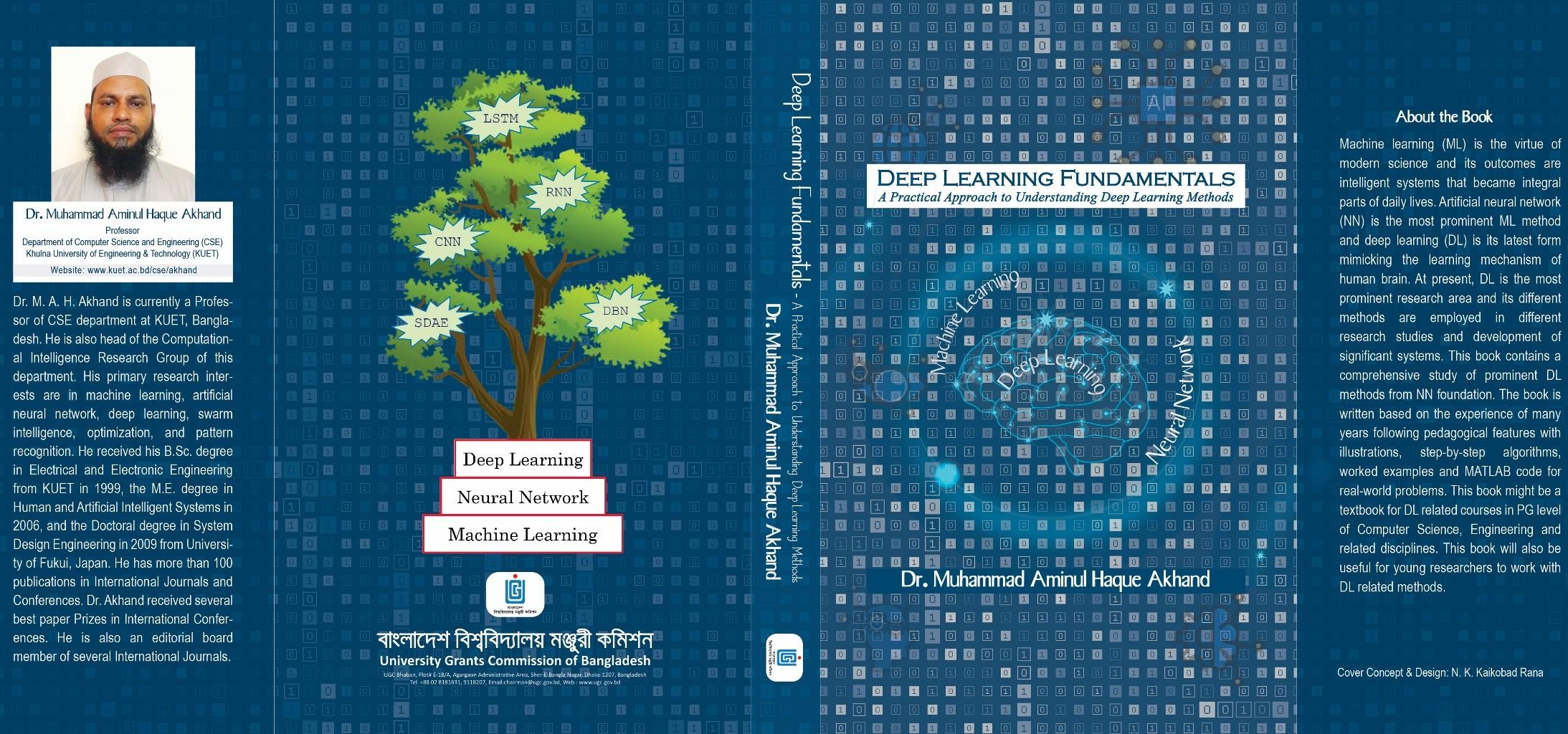
Deep Learning Fundamentals
- A Practical Approach to Understanding Deep Learning Methods
2
https://kuet.ac.bd/cse/akhand/

Slide 3
Contents
3
Introduction
Biological Neural Networks
Artificial Neural Networks
Neural Networks for Classification Tasks
Performance Evaluation and Benchmark Problems

Slide 4
Why Artificial Neural Networks?
4
Human brain has many desirable characteristics not presented in modern computers:
massive parallelism,
distributed representation and computation, learning ability,
generalization ability,
adaptability,
inherent contextual information processing, fault tolerance, and
low energy consumption.
It is hope that devices based on biological neural networks will process some of
these characteristics.

Slide 5
Why Artificial Neural Networks?
5
Modern digital computers outperform humans in the domain of numeric computation and the related symbolic manipulation.
However, humans can solve complex perceptual problems effortlessly, and
more efficiently than the world's fastest computer.
Human performs these remarkable benefits due to the characteristics of his/her neural system whose (neural system) working procedure is completely different from a conventional computer system.

Slide 6
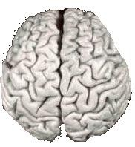

Comparison of Brains and Traditional Computers
200 billion neurons, 32 trillion synapses
Element size: 10⁻⁶ m
Energy use: 25W
Processing speed: 100 Hz
Parallel, Distributed
Fault Tolerant
Learns: Yes
Intelligent/Conscious:
Usually
1 billion bytes RAM but trillions of bytes on disk
Element size: 10⁻⁹ m
Energy watt: 30-90W (CPU)
Processing speed: 10⁹ Hz
Serial, Centralized
Generally not Fault Tolerant
Learns: Some
Intelligent/Conscious: Generally
No

Slide 7
von Neumann Computer vs. Biological Neural System
7
 | von Neumann Computer | Biological Neural System
processor | complex high-speed one (or a few) | simple low-speed a large number
memory | separate localized noncontent addressable | integrated in the neuron distributed content addressable
computing | centralized sequential strored-programs | distributed parallel self-learning
reliability | vulnerable | robust
expertise | numerical symbolic | perceptual problems manipulations
environment | well-defined | poorly defined unconstrained

Slide 8
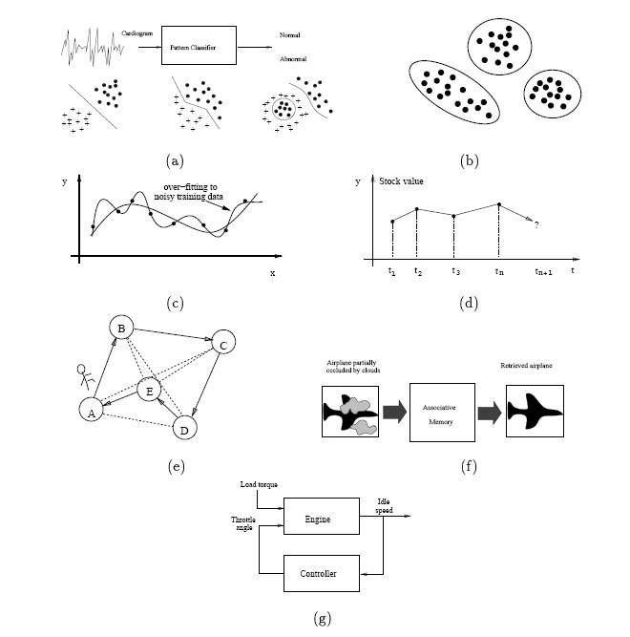
The Goal
8
ANN is designed with the goal of building intelligent machines to solve complex perceptual problems, such as pattern recognition and optimization, by mimicking the networks of real neurons in the human brain.
Tasks handled by ANNs

Slide 9
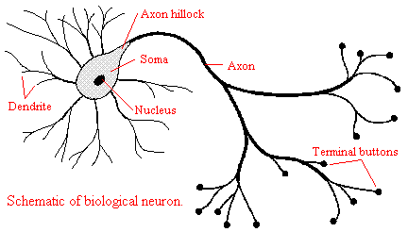
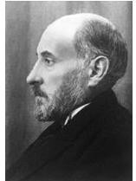
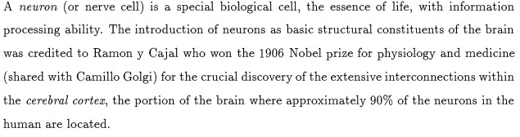
Artificial Neural Networks(ANNs) Motivations
9
ANNs are inspired by biological neural networks

Slide 10
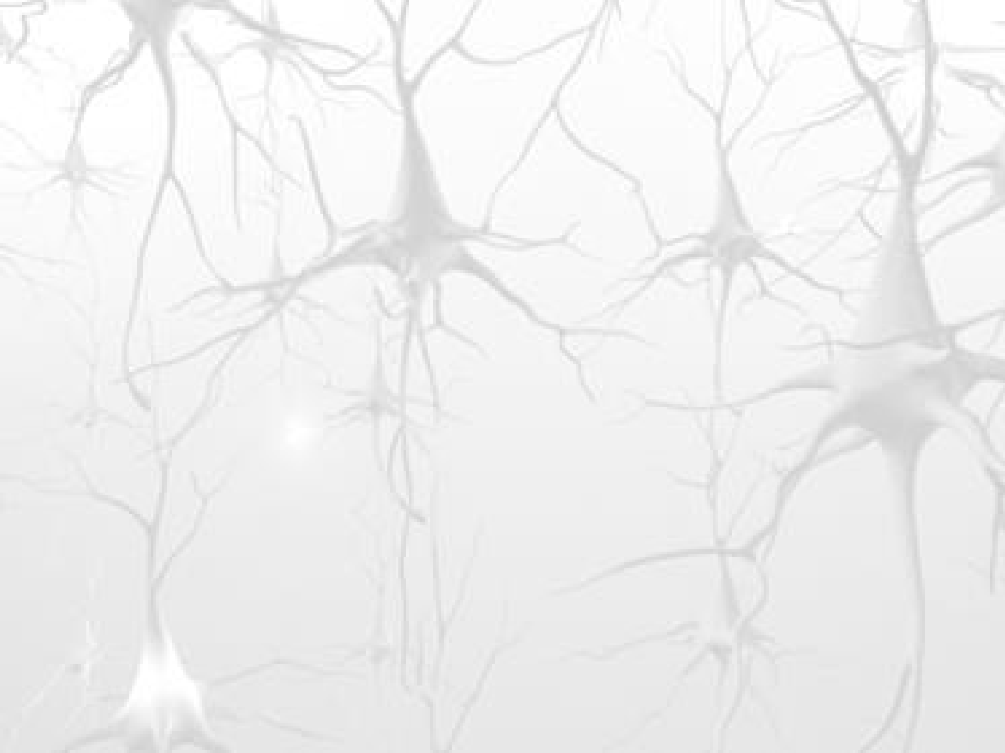

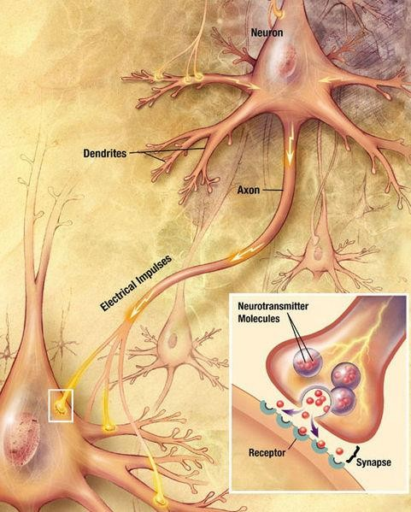

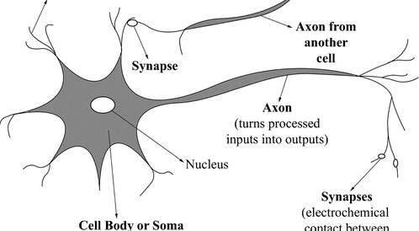

Biological Neuron
10
Dendrite
Figure 1.1: A sketch of a biological neuron.

Slide 11
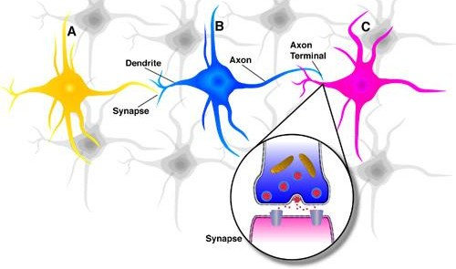
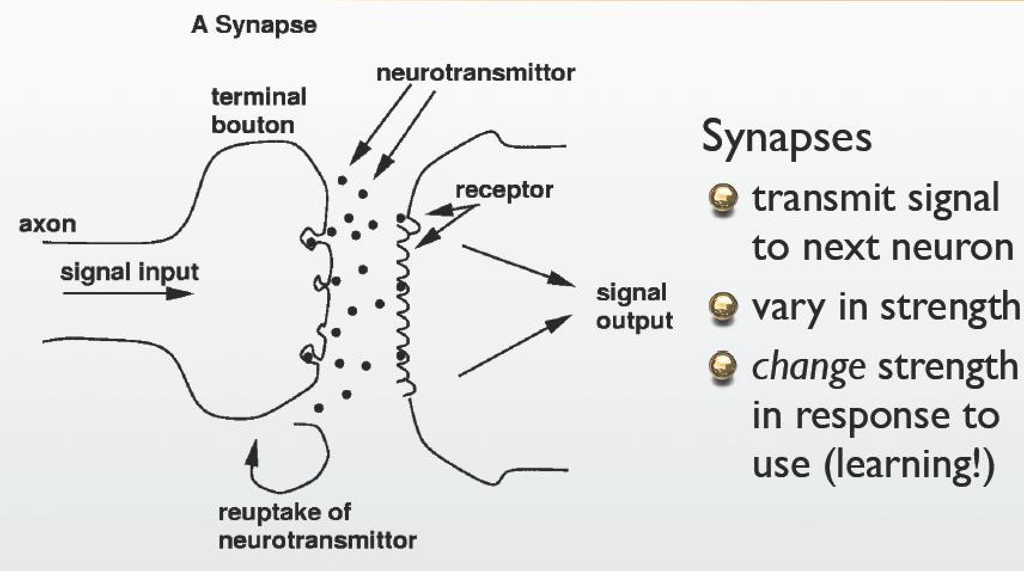
Synapses
11

Slide 12
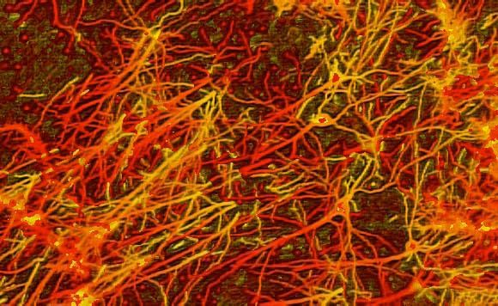
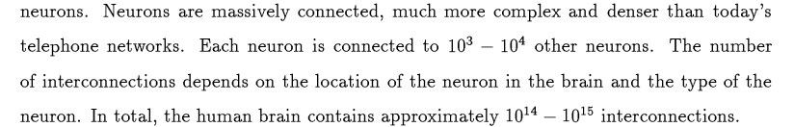
A Real Neural Network
12

Slide 13
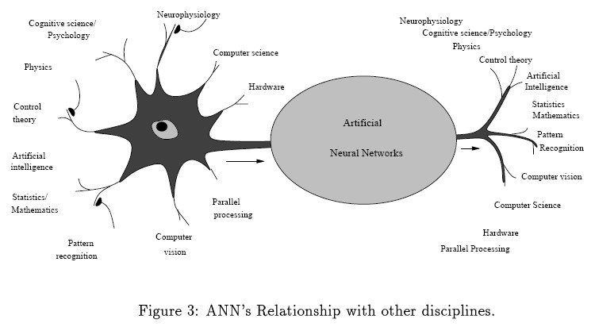
ANN’s Relationship with Other Disciplines
13

Slide 14

14
Computational Model
X₁
Bias (X₀ or b) = 1
X₁
W₁
W₁
W₀
X₂
Input signals
W₂
Σ
Summing unit
X₂
Output (Y)
W₂
Σ
Summing unit
u
h
y
W_{N}
Activation function
X_{N}
W_{N}
Synaptic weights
X_{N}
Synaptic
weights
Figure 1.2: McCulloch-Pitts model of a neuron.
Figure 1.3: Generalized model of an artificial neuron.
(a) (b) (c) (d)
Figure 1.4: Different types of activation functions: (a) threshold, (b) piecewise linear, (c) sigmoid, and (d) Gaussian.

Slide 15
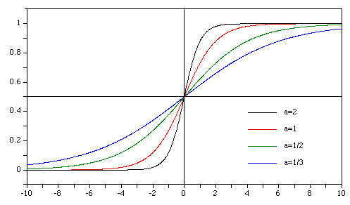
Sigmoid Activation Function
15
y
a=2
Slope (a) decreased
y=1/(1+exp(-ax))
a=1
a=1/3
a=1/2
x
Figure 1.5: Sigmoid function with various slope (a) values.

Slide 16
Ability of Single Neuron
x₁
x₀ w₀
Bias (x₀ =1,always)
w₁
x₂
w₂
Inputs
⎧
n
Output
_{σ =} ⎪1 if
∑ ^{w}i ^{x}i
0
x
⎨
3
w
i=0
3
⎪⎩0 else
x₄
w₄
x₅ w₅

Slide 17
Logical Operators
x₂
x₂
x₂
+
+
−
+
+
−
AND
OR
XOR
−
+
x₁
−
−
x₁
−
+
x₁
x₂
x
x₂
2
−
+
−
−
+
−
XNOR
NAND
NOR
XNOR
+
x
−
x
+
−
x₁
+ 1
+
1

Slide 18
Logical Operators
xx0₀
x₂
+
+
-0.5
x₁
OR
1
⎧
n
∑
OR
_{σ =} ⎪1 if
w_{i} x_{i} > 0
⎨
i=0
x₁
x
⎪⎩0 else
−
+
2
1
x₂
x₀
-1.5
x₁
AND
−
+
⎧
n
1
⎪1 if
∑ i i
σ =
w x > 0
⎨
i=0
AND
x
⎪⎩0 else
2
1
x
x₀
0.0
−
−
1
⎧
n
NOT
⎪1 if
∑ i i
x₁
σ =
w x > 0
⎨
i=0
-1.0
⎪⎩0 else

Slide 19
Nonlinear Problem
x₂
x₀
?
+
−
x
1
?
⎧
n
∑
XOR
_{σ =} ⎪1 if
w_{i} x_{i} > 0
XOR
⎨
i=0
x
⎪⎩0 else
2
?
−
+
x₁
No arrangement work, not linearly separable. Require two boundary lines.

Slide 20


XOR solution in Higher Dimension
20
(1, 1, 1)
0
+1
- 1.5
+1
Σ
AND
+1
1
X₁
Logic Inputs
- 2
- 0.5
(0, 1, 0)
+1
+1
Σ
X₂
+1
Y (XOR)
0
1
(0, 0, 0)
(1, 0, 0)
a) Third dimension uplift XOR (1, 1) as (1, 1, 1) in three dimension.
b) XOR solution with additional input from AND gate.
Figure 1.8: Solution of XOR in three dimension.
An additional dimension (input) converts the problem to a linearly separable.

Slide 21
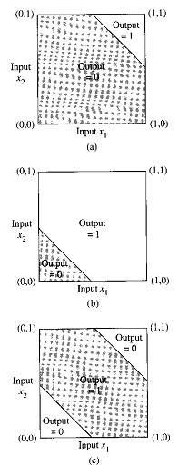

XOR solution with HN
21
+1
- 1.5
AND
+1
+1 Σ
H₁ (AND)
X₁
- 0.5
- 2
Logic Inputs
+1
Σ
+1
Y (XOR)
+1
H₂ (OR)
X₂
+1
Σ
- 0.5
OR
+1
Figure 1.9: XOR logic combining AND and OR logic operations.
XOR
XOR logic through manipulation by hidden neurons

Slide 22
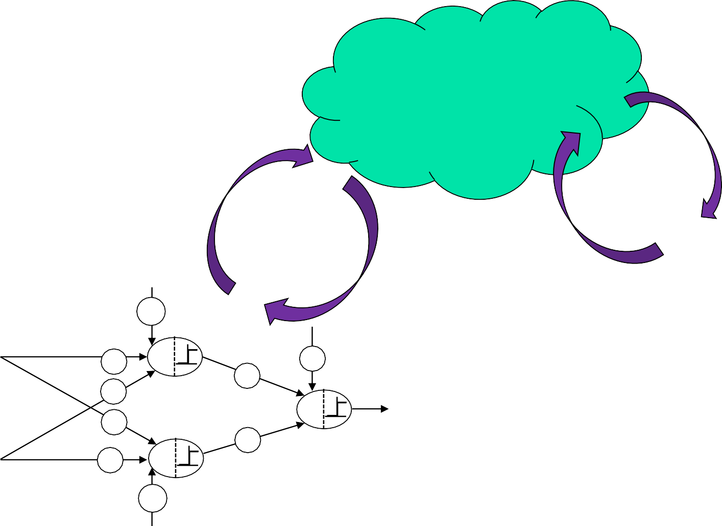
Learning
22
Learning Method
/ Algorithm
Environment / Data
X1 | X2 | XOR
0 | 0 | 0
0 | 1 | 1
1 | 0 | 1
1 | 1 | 0
+1
- 1.5
+1
Σ
H₁ (AND)
X₁
+1
- 0.5
- 2
Logic Inputs
+1
Σ
+1
Y (XOR)
+1
H₂ (OR)
X₂
+1
Σ
- 0.5
+1

Slide 23
Learning
23
The ability to learn is a fundamental trait (characteristic) of intelligence.
ANN-> Updating NN architecture and connection weights to perform a specific task efficiently.
ANN ability to automatically learning from examples makes them attractive.
To understand or design a learning process need: a model of environment or information is available to NN and learning rules.
A learning algorithm -> procedure for adjusting weights
Three main learning paradigms-> Supervised (learning with a teacher), unsupervised and hybrid
Reinforcement learning is variant of supervised learning receives critique on
the correctness of network output instead of correct answer.

Slide 24
Learning
24
Learning theory must address three fundamental and practical issues:
Capacity – how many patterns can be stored , what functions and decision boundaries a NN can perform
Sample Complexity – Number training patterns needed to train
Computational Complexity – Time required for a learning algorithm to estimate a solution
Four basic types of Learning rules: Error-Correction, Boltzman, Hebbian, and
Competitive.
X1 | X2 | XOR
0 | 0 | 0
0 | 1 | 1
1 | 0 | 1
1 | 1 | 0

Slide 25
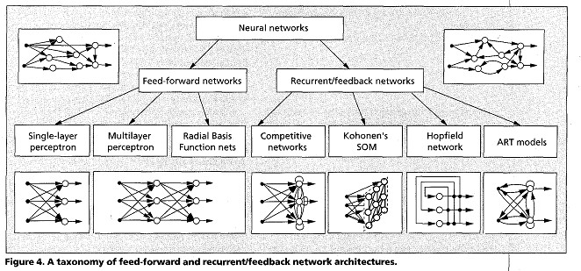
Network Architecture / Topology
25
Based on Connection pattern (architecture): feed forward and recurrent (feedback)
Different architectures require appropriate learning algorithms.

Slide 26
Well Known Learning Algorithms
27
Paradigm | Learning rule | Architecture | Learning algorithm | Task
Supervised | Error-correction | Single- or multilayer | Perceptron learning algorithms | Pattern classification
 |  | perceptron | Back-propagation | Function approximation
 |  |  | Adaline and Madaline | Prediction, control
 | Boltzmann | Recurrent | Boltzmann learning algorithm | Pattern classification
 | Hebbian | Multilayer feed-forward | Linear discriminant analysis | Data analysis
 |  |  |  | Pattern classification
 | Competitive | Competitive | Learning vector quantization | Within-class categorization
 |  |  |  | Data compression
 |  | ART network | ARTMap | Pattern classification
 |  |  |  | Within-class categorization
Unsupervised | Error-correction | Multilayer feed-forward | Sammon's projection | Data analysis
 | Hebbian | Feed-forward or competitive | Principal component analysis | Data analysis
 |  |  |  | Data compression
 |  | Hopfield Network | Associative memory learning | Associative memory
 | Competitive | Competitive | Vector quantization | Categorization
 |  |  |  | Data compression
 |  | Kohonen's SOM | Kohonen's SOM | Categorization
 |  |  |  | Data analysis
 |  | ART networks | ART1, ART2 | Categorization
Hybrid | Error-correction and competitive | RBF network | RBF learning algorithm | Pattern classification
 |  |  |  | Function approximation
 |  |  |  | Prediction, control

Slide 27
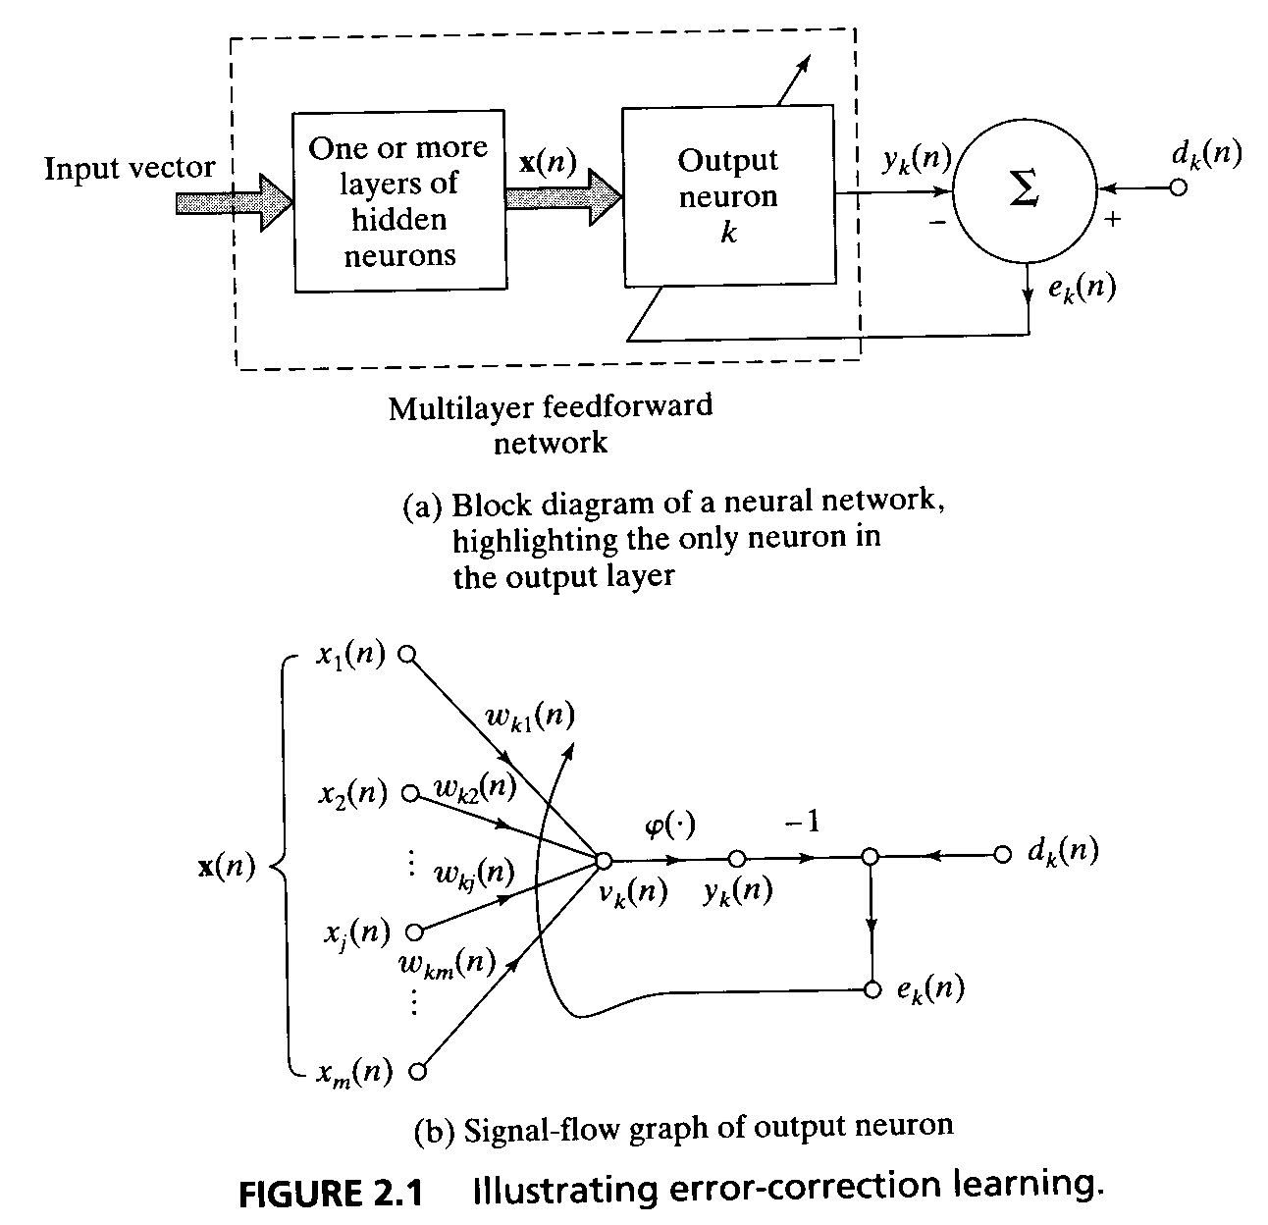
Learning Rule: Error-Correction
28
error signal = desired response – output signal
e_{k}(n) = d_{k}(n) –y_{k}(n)
e_{k}(n) actuates a control mechanism to make the output signal y_{k}(n) come closer to the desired response d_{k}(n) in step by step manner

Slide 28
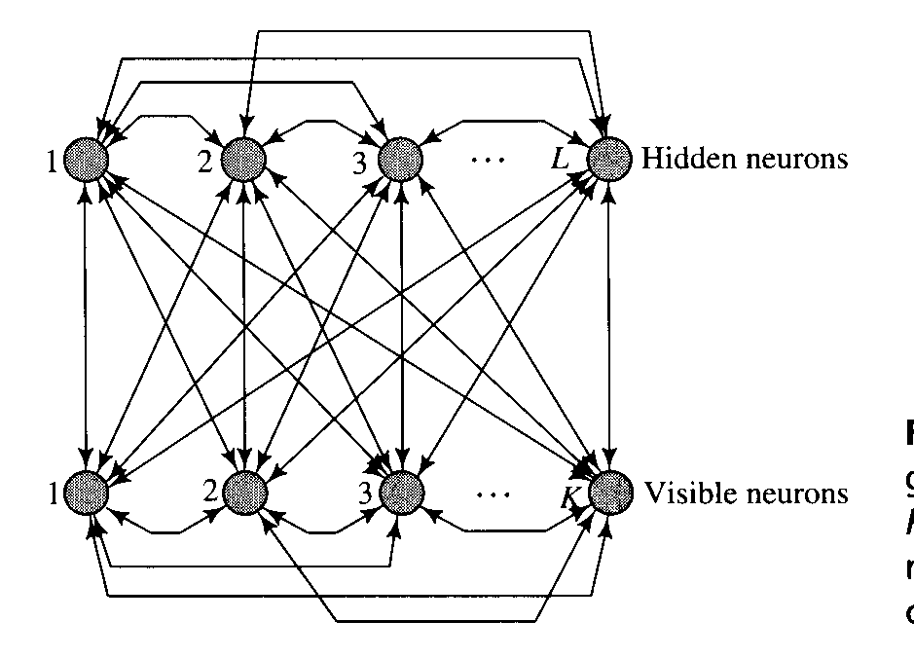
Learning Rule: Boltzmann
The primary goal of Boltzmann learning is to produce a neural network that correctly models input patterns according to a Boltzmann distribution.
The Boltzmann machine consists of stochastic neurons. A stochastic neuron resides in one of two possible states (± 1) in a probabilistic manner.
The use of symmetric synaptic connections between neurons.
The stochastic neurons partition into two functional groups: visible and hidden.
During the training phase of the network , the visible neurons are all clamped onto specific states determined by the environment.
The hidden neurons always operate freely; they are used to explain underlying constraints contained in the environmental input vectors.

Slide 29
Learning Rule: Hebbian
If two neurons on either side of synapse (connection) are activated simultaneously, then the strength of that synapse is selectively increased.
If two neurons on either side of a synapse are activated asynchronously, then that synapse is selectively weakened or eliminated.
A Hebbian synapse increases its strength with positively correlated presynaptic and postsynaptic signals, and decreases its strength when signals are either uncorrelated or negatively correlated.

Slide 30
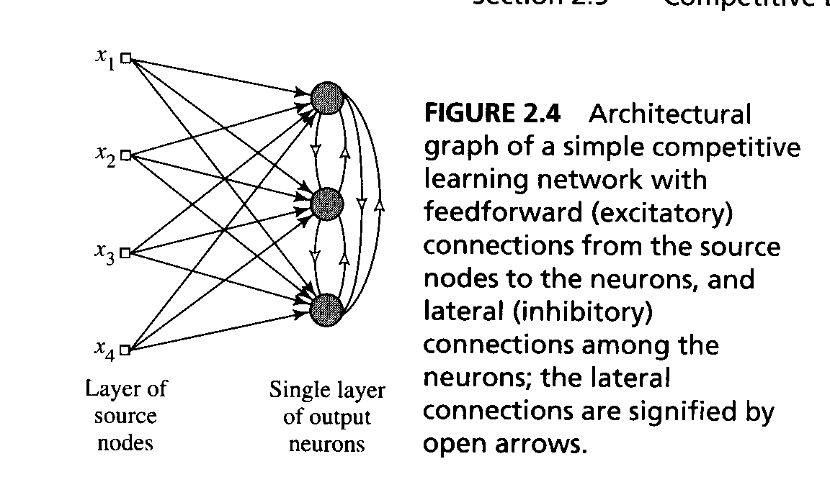
Learning Rule: Competitive
The output neurons of a neural network compete among themselves to become active.
- a set of neurons that are all the same (excepts for synaptic weights)
- a limit imposed on the strength of each
neuron
- a mechanism that permits the neurons to compete -> a winner-takes-all
The standard competitive learning rule
Δw_{kj} = η(x_{j}-w_{kj}) if neuron k wins the competition
= 0 if neuron k loses the competition

Slide 31
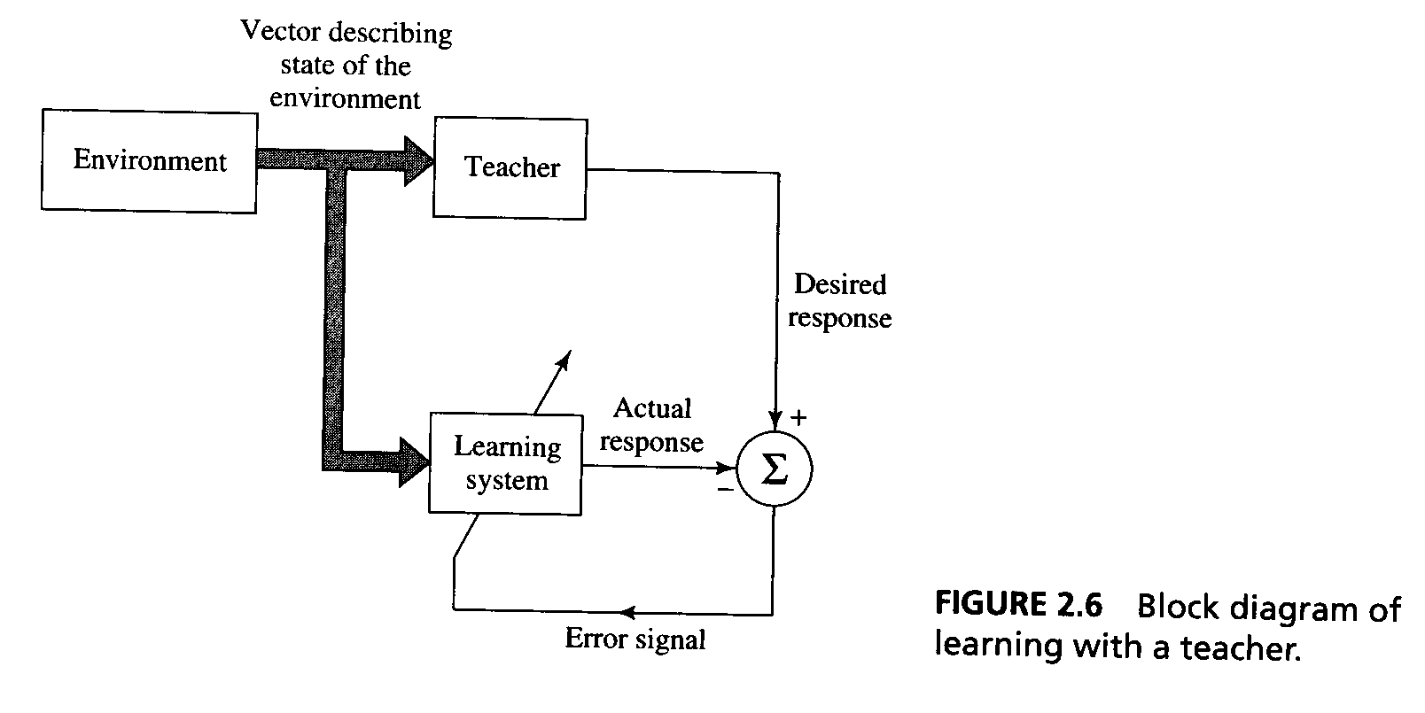
Learning Paradigms : Learning with a Teacher
Learning with a Teacher (=supervised learning) The teacher has knowledge of the environment

Slide 32
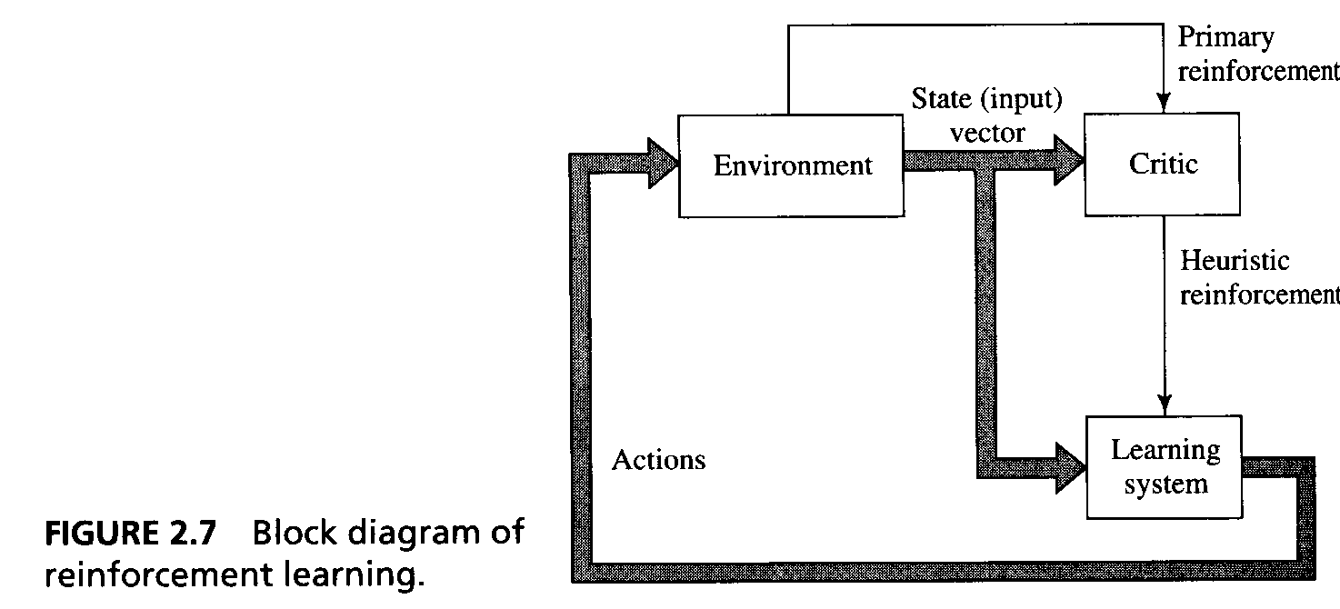
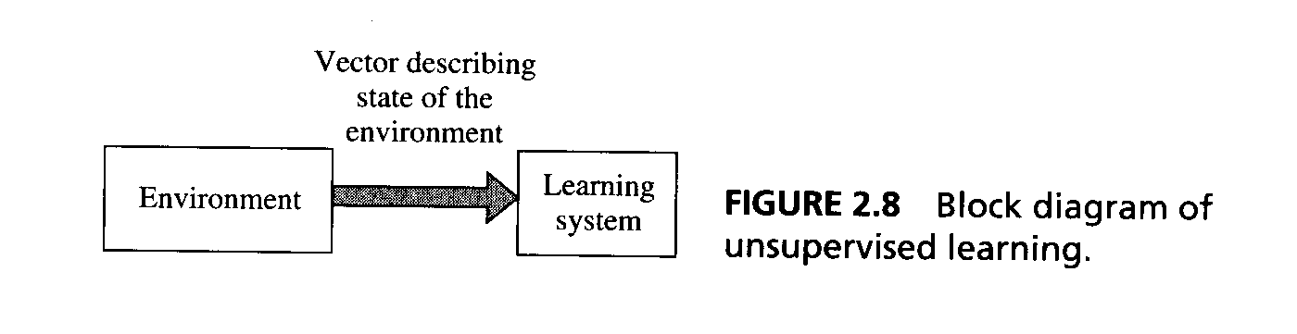
Learning Paradigms: Learning without a Teacher
Learning without a Teacher: no labeled examples available of the function to be learned.
Reinforcement learning
Unsupervised learning

Slide 33
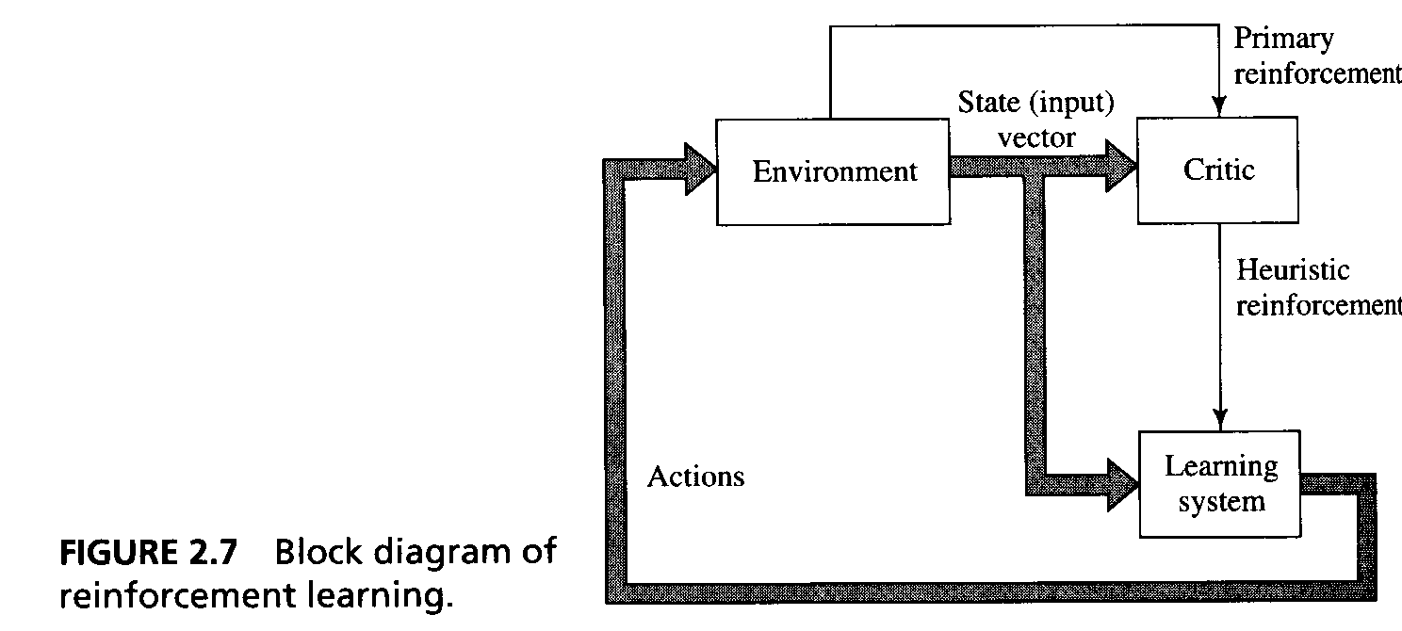
Learning Paradigms: Reinforcement
Reinforcement learning:
The learning of input-output mapping is performed through continued interaction with the environment in oder to minimize a scalar index of performance.

Slide 34
Learning Paradigms: Unsupervised
Unsupervised Learning: There is no external teacher or critic to
oversee the learning process.
The provision is made for a task independent measure of the quality of representation that the network is required to learn.

Slide 35
Training of Multilayer Feed-Forward Neural Networks : Back-propagtaion
36

Slide 36
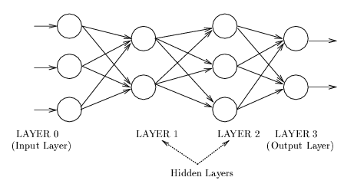
Multilayer Feed-Forward Neural Networks
37
Feed -forward Networks
A connection is allowed from a node in layer i only to nodes in layer i + 1.
Most widely used architecture.
Conceptually, nodes at higher levels successively abstract features from preceding layers

Slide 37
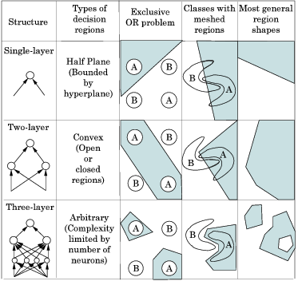
Geometric interpolation of the role of HN
38

Slide 38
How to get appropriate weight set?
Back-propagation is the famous algorithm for training feed-forward networks
http://en.wikipedia.org/wiki/Backpropagation
Backpropagation, or propagation of error, is a common method of teaching artificial neural
networks how to perform a given task.
It was first described by Paul Werbos in 1974, but it wasn't until 1986, through the work of David E. Rumelhart, Geoffrey E. Hinton and Ronald J. Williams, that it gained recognition, and it led to a “renaissance” in the field of artificial neural network research.

Slide 39
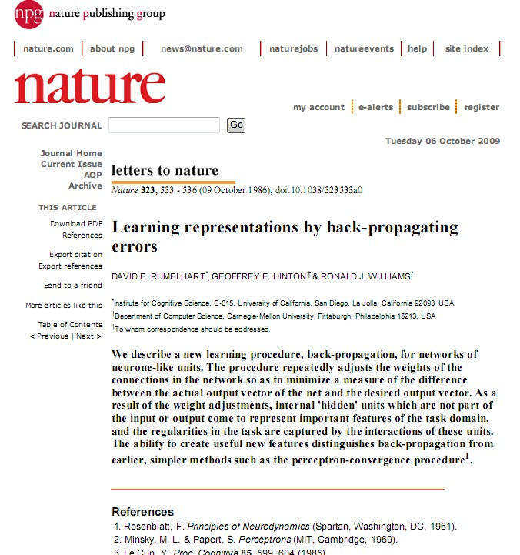
40

Slide 40



Back-propagation(BP)
Error = Desired Output
- Actual Output
Input
Output
(Input Layer) (Hidden Layer) (Output Layer)
Forward Pass: Error is calculated based on desired and actual output.
Backward Pass: Synaptic weights are adjusted based on calculated error.

Slide 41



Back-propagation
y_{j}
(Input Layer)
(Hidden Layer)
(Output Layer)

Slide 42
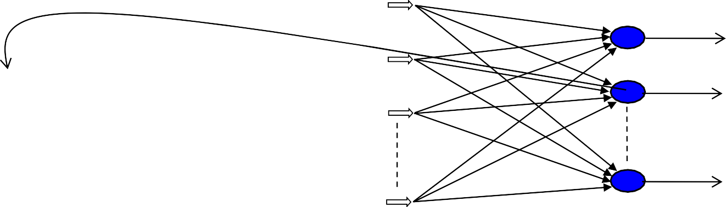
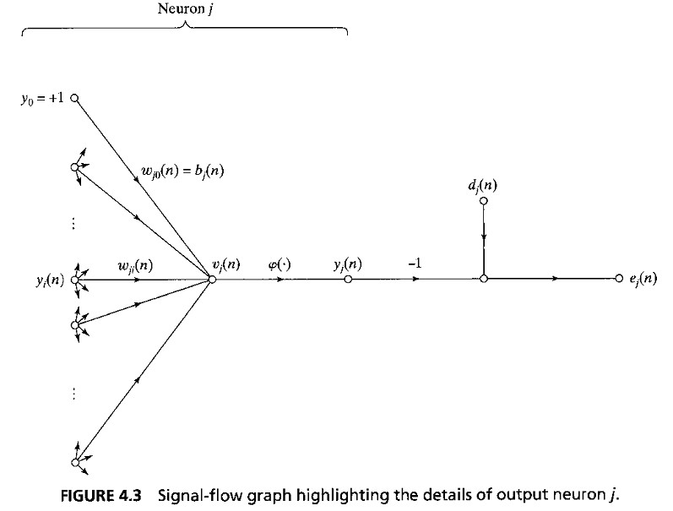

Back-propagation (Without HN)
43
y_{j}
(Input Layer)
(Output Layer)
Activation Function
∑
Forward Pass:
Backward Pass:

Slide 43
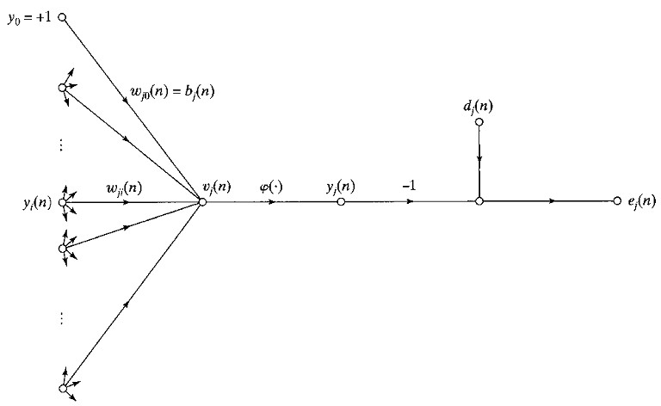






44
Activation Function
∑
Depends on Activation Function

Slide 44
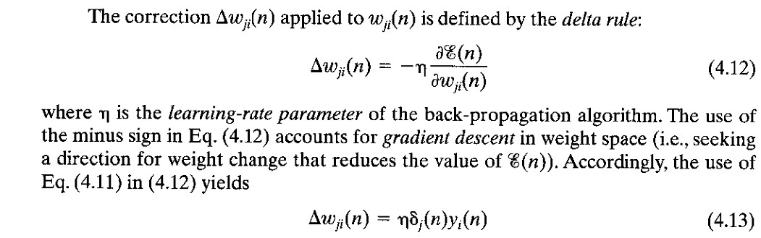




45
Activation Function
∑

Slide 45



Weight Update Sequence in BP
i=0
bias
^{w}10
y₁
i=1
^{w}1m ^{w}j0
y_{j}
e_{j} = d_{j}- y_{j}
^{w}jm
i=m
(Input Layer)
(Output Layer)

Slide 46
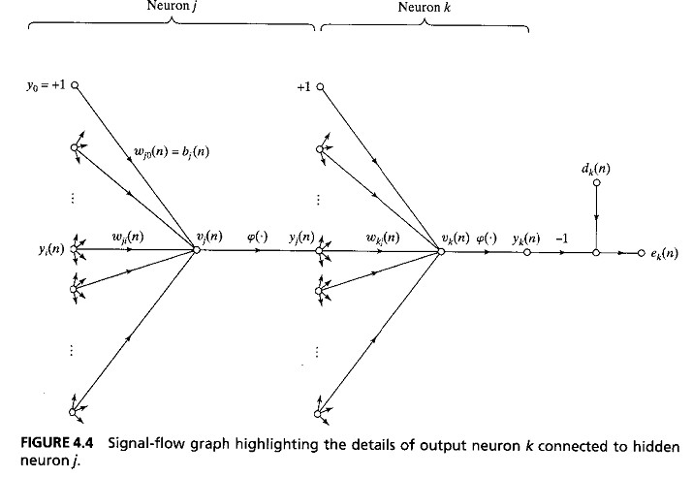





BP for Multilayer (With HN)
Input
y_{j}
y_{k}
Output

Slide 47
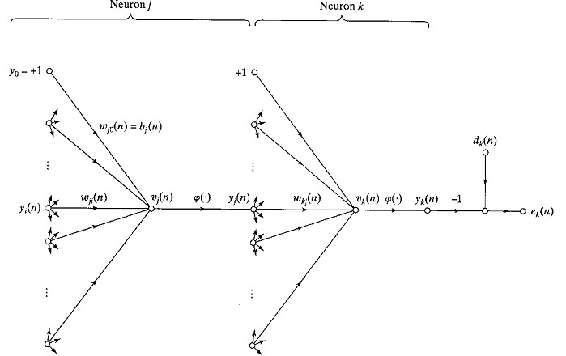
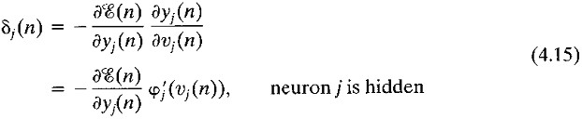







BP for Multilayer (With HN)

Slide 48
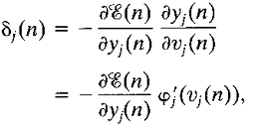

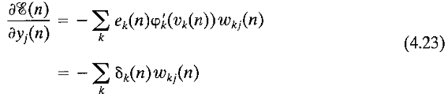
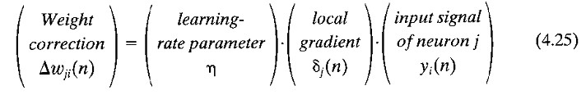
BP for Multilayer (With HN)

Slide 49
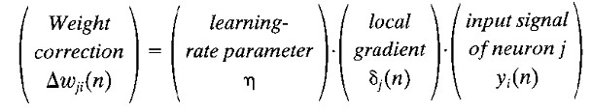
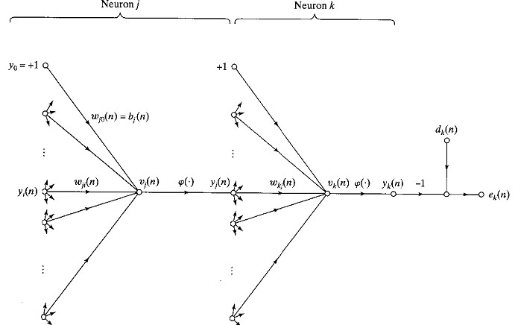
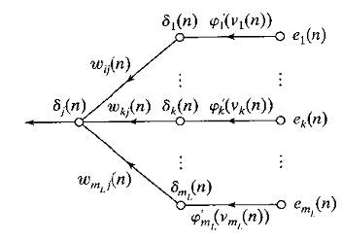
BP for Multilayer (With HN)
w_{ji}(t+1)=w_{ji}(t)+Δw_{ji}
δ_{k} (n)=e_{k}(n)φ’(v_{k}(n)) for k output neuron

Slide 50
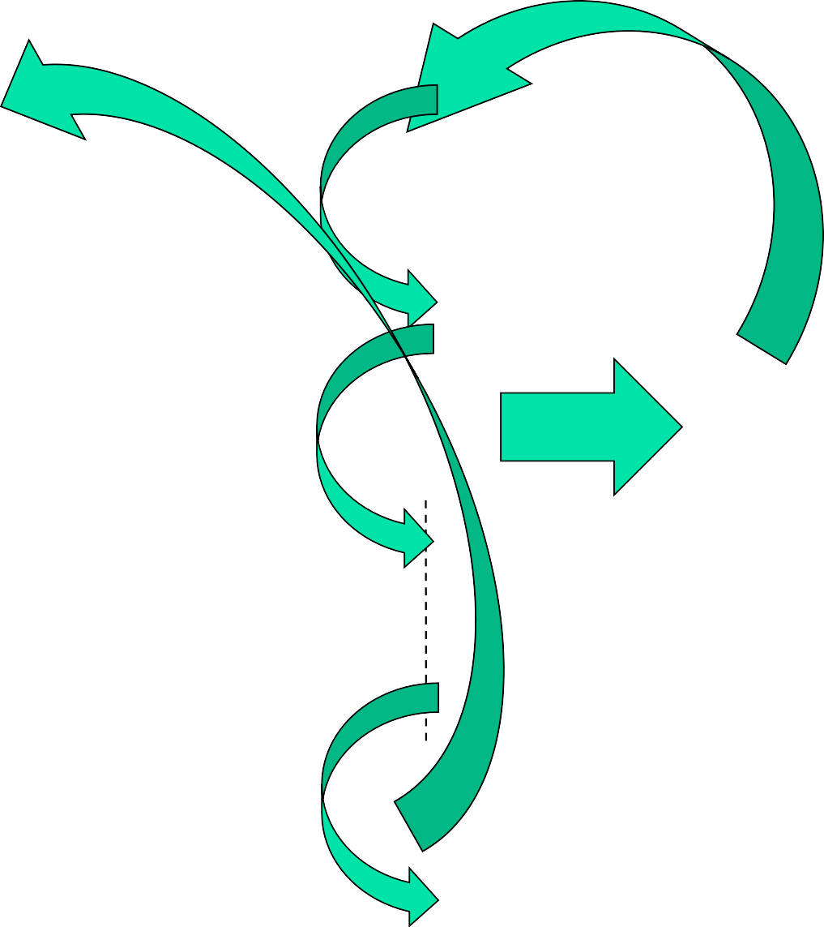
Weight Update Sequence in BP
i=0
bias
^{w}10
y₁
i=1
^{w}1m ^{w}j0
y_{j}
e_{j} = d_{j}- y_{j}
^{w}jm
i=m

Slide 51
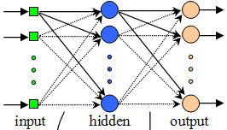
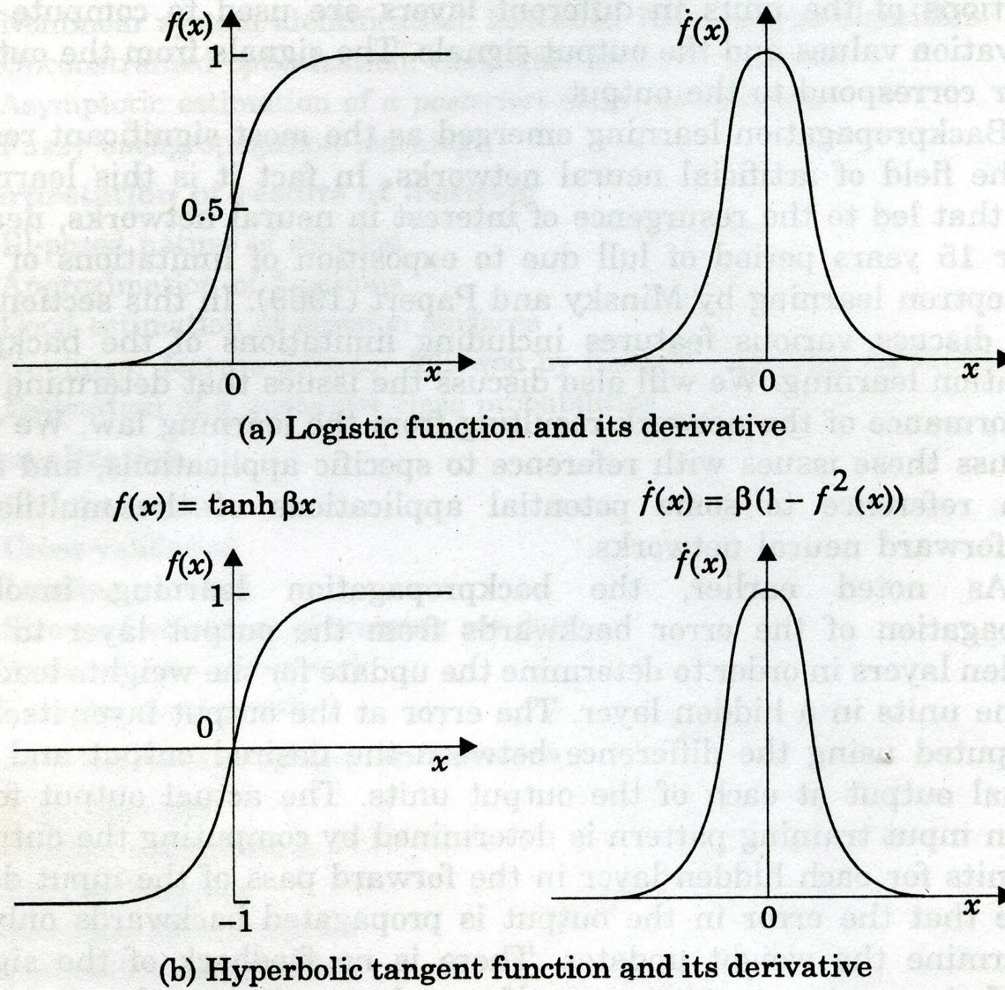

Matter of Activation Function(AF)
f(x)=1/(1+exp(-βx)
f ’(x)= β f(x)(1-f(x))
Max. 0.25β at f(x)=0.5
δ_{k} (n)=e_{k}(n)φ’(v_{k}(n))
k & j are output
& hidden layer neuron
Differentiability is the only condition for AF
an example of continuously differentiable nonlinear AF is sigmoidal nonlinearity; its two forms are :

Slide 52

BP at a Glance
53
Δw = η δ x
The local gradient of output unit (δ_{o} ) and hidden unit (δ_{h}) are defined by:
₌ ₋ ∂e ∂f_{o}
h ∑ o
∂f
δ
δ = δ w
h
o
∂f ∂x
o
º ∂x
o o
h
1
∂e (n)
= −(d (n) − f (n))
e(n) = (d (n) −
2
2
o
f (n)) ,
∂f_{o} (n)
o
o
∂f (n)
f_{o} (n) = 1/(1+ exp(− x_{o} (n)))
o
= f (n)(
1 − f (n))
For logistic sigmoid activation function
∂x (n)
o
o
o
δ_{o} = (d(n) − f_{o} (n)) f_{o} (n)(1− f_{o} (n))
Now the local gradient of output unit (δ_{o}) becomes
For the same sigmoid activation function the local
gradient of hidden unit (δ_{h}) becomes
δ_{h} = f_{h} (n)(1 − f_{h} (n))∑δ_{o} w_{o}
o

Slide 53
Operational flowchart of a NN with Single Hidden Layer
54
Hidden layer
H
Output layer
Wo
Actual Output
Input
Wh
∑
Error
-1
1
Desired Output
∆Wh
𝛿_{ℎ}
∆Wo
𝛿₀

Slide 54
Operational flowchart of a NN with Two Hidden Layer
55
Hidden Layer 1
Hidden Layer 2
H2
Output layer
H1
W2
W1
W3
Actual Output
-1
Input
∑
Error
1
Desired Output
∆W1
^{𝛿}ℎ1
∆W2
^{𝛿}ℎ2
∆W3
𝛿₀

Slide 55



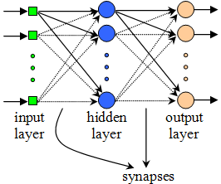
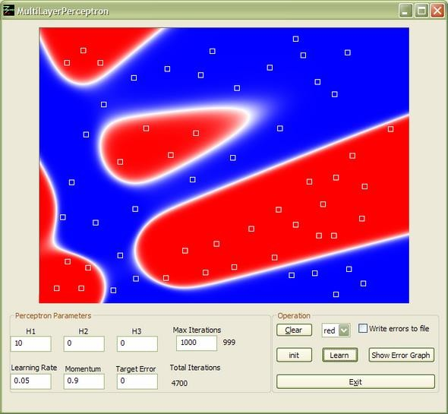
A MLP Simulator for Simple Application
56

Slide 56


Hossein Khosravi : The Developer of the Simulator
57
https://www.codeproject.com/Articles/9447/Neural-Network-Classifier

Slide 57
58
Lets run the simulator

Slide 58
Practical Aspects of BP
59

Slide 59
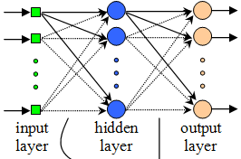
Practical Considerations
60
Training Data: Sufficient / proper training data is require for proper input- output mapping.
Network Size: Complex problem require more hidden neurons and may perform better with multiple hidden layers.
Weight Initialization: NN works on numeric data. Before training all the synaptic weights are initialized with small random values, e.g., -0.5 to +0.5.
Learning Rate (η) and Momentum Constant (α): A small η results slower convergence and its larger value gives oscillation. Momentum also speed up training but larger α with large η arise oscillation.
Stopping Training: Training should stop at better generalization position.

Slide 60
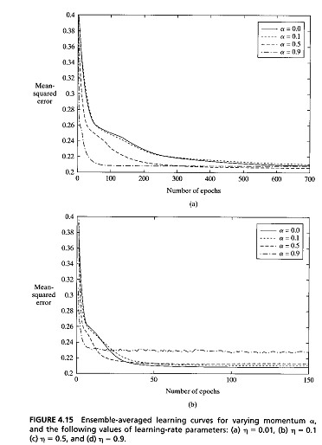
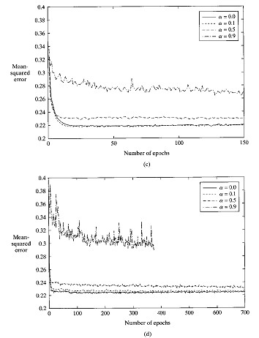
Effect of Learning Rate (η) and Momentum Constant (α) values
61

Slide 61
Learning and Generalization
62
Learning and generalization are the most important topics in NN research. Learning is the ability to approximate the training data while generalization is the ability to predict well beyond the training data.
Available
Data
Training Set
(Use for learning)
Generalization is more desirable because the common use of a NN is to make good prediction on new or unknown objects.
It measures on the testing set that is reserved from available
data and not use in the training.
Testing error rate (TER), i.e., rate of wrong classification on testing set, is widely acceptable quantifying measure, which value minimum is good.
Testing Set
(Reserve to measure
generalization)
TER = | Total testing set misclassified patterns
 | Total testing set patterns

Slide 62



Learning and Overfitting
63
Available Data
Training Set
(Use for learning)
Testing Set
(Reserve to measure
generalization)
Where we find benchmark data for testing NNs or machine learning?

Slide 63
Benchmark Problems for Evaluation
64
A benchmark is a point of reference by which something can be measured.
For NN or machine learning, the most popular benchmark dataset collection is the University of California, Irvine (UCI) Machine Learning Repository (http://archive.ics.uci.edu/ml/).
UCI contains raw data that require preprocessing to use in NN. Some preprocessed data is also available at Proben1 (ftp://ftp.ira.uka.de/pub/neuron/).
Various persons or groups also maintain different benchmark datasets for specific purpose: Delve (www.cs.toronto.edu/~delve/data/datasets.html), Orange (www.ailab.si/orange/datasets.asp), etc.

Slide 64

65

Slide 65
Benchmark Problems
66
Problems Related to Human Life
Problem | Task
Breast Cancer Wisconsin | Predicts whether a tumor is benign (not dangerous to health) or malignant (dangerous) based on a sample tissue taken from a patient’s breast.
BUPA Liver Disorder | Identify lever disorders based on blood tests along with other related information such as alcohol consumption.
Diabetes | Investigate whether the patient shows or not the signs of diabetes.
Heart Disease Cleveland | Predicting whether at least one of four major heart vessels is reduced in diameter by more than 50%.
Hepatitis | Anticipate status (i.e., live or die) of hepatitis patient.
Lymphography | Predict the situation of lymph nodes and lymphatic vessels.
Lungcancer | Identify types of pathological lung cancers.
Postoperative | Determine place to send patients for postoperative recovery.

Slide 66
Benchmark Problems
67
Problems Related to Finance
Problem | Task
Australian Credit Card | Classify people as good or bad credit risks depend on applicants’ particulars.
Car | Evaluate cars based on price and facilities.
Labor Negotiations | Identify a worker as good or bad i.e., contract with him beneficial or not.
German Credit Card | Like Australian Card, this problem also concerns to predict the approval or non-approval of a credit card to a customer.
Problems Related to Plants
Problem | Task
Iris Plants | Classify iris plant types.
Mushroom | Identify whether a mushroom is edible or not based on a description of the mushroom’s shape, color, odor, and habitat.
Soybean | Recognize 19 different diseases of soybeans.

Slide 67
68 |  | Benchmark Problems and NN Architecture
 |  |  |  |  | After Preprocessing |  |  |  |  | Depends on Problem
Abbr. |  | Problem | Total Examp | Input Features |  |  | NN Architecture |  |  |  | Input Features of Diabetes Number of times pregnant Plasma glucose concentration Diastolic blood pressure Triceps skin fold thickness (mm) 2-Hour serum insulin (mu U/ml) Body mass index Diabetes pedigree function Age
 |  |  |  | Cont. |  | Discr. | Inputs | Class | Hidd. Node
ACC |  | Australian Credit Card | 690 | 6 |  | 9 | 51 | 2 | 10
BLN |  | Balance | 625 | - |  | 4 | 20 | 3 | 10
BCW |  | Breast Cancer Wisconsin | 699 | 9 |  | - | 9 | 2 | 5
CAR |  | Car | 1728 | - |  | 6 | 21 | 4 | 10
DBT |  | Diabetes | 768 | 8 |  | - | 8 | 2 | 5
GCC |  | German Credit Card | 1000 | 7 |  | 13 | 63 | 2 | 10
HDC |  | Heart Disease Cleveland | 303 | 6 |  | 7 | 35 | 2 | 5
HPT |  | Hepatitis (HPT) | 155 | 6 |  | 13 | 19 | 2 | 5
HTR |  | Hypothyroid | 7200 | 6 |  | 15 | 21 | 3 | 5
HSV |  | House Vote | 435 | - |  | 16 | 16 | 2 | 5
INS |  | Ionosphere | 351 | 34 |  | - | 34 | 2 | 10
KRP |  | King+Rook vs King+Pawn | 3196 | - |  | 36 | 74 | 2 | 10
LMP |  | Lymphography | 148 | - |  | 18 | 18 | 4 | 10
PST |  | Postoperative | 90 | 1 |  | 7 | 19 | 3 | 5
SBN |  | Soybean | 683 | - |  | 35 | 82 | 19 | 25
SNR |  | Sonar | 208 | 60 |  | - | 60 | 2 | 10
SPL |  | Splice Junction | 3175 | - |  | 60 | 60 | 3 | 10
WIN |  | Wine | 178 | 13 |  | - | 13 | 3 | 5
WVF |  | Waveform | 5000 | 21 |  | - | 21 | 3 | 10
ZOO |  | Zoo | 101 | 15 |  | 1 | 16 | 7 | 10
Problems show variations in number of examples, input features and classes.

Slide 68
An Application of Feed Forward Neural Network Optical Character Recognition(OCR)
69

Slide 69


Optical Character Recognition(OCR)
70

